Slide 1

AIRLINE PRICE PREDICTION
Aniket Khedkar
Jacob ferguson

Slide 2
Introduction
Air travel is an essential part of modern life—used for business, vacations, and personal travel
Airline ticket prices can vary widely based on many dynamic factors.
Factors include distance, passenger class, airline, amenities, and timing.
Accurate price prediction can benefit both airlines and passengers.
Our goal is to build a model that predicts airline prices using real-world data.

Slide 3

Contributions
Jacob
Data Collection
Data Cleaning
Validation
Aniket
Data Preprocessing
Model Implementation
Evaluation
Visualization

Slide 4
Dataset Description
452,088 flight records with 11 features
Operational Factors:
Flight duration, stops, departure time (red-eye vs. peak).
Temporal Factors:
Days left until booking, weekend travel (is_weekend).
Service Tier:
Economy vs. premium class (Class).
Airline & Route:
Brand value (Airline_Code), source-destination pairs (Route).

Slide 5
Data Cleaning and Preprocessing
Removed duplicate entries
Converted categorical 'Total_stops' to numerical (0, 1, 2)
Extracted airline code from Flight_code
Created cyclical features for days of the week
Added weekend indicator feature
Created route combination feature
Converted departure time to numerical categories
Created fare per hour feature for better price comparison

Slide 6
Data Preprocessing
Feature Engineering:
Numerical features: Duration_in_hours, Days_left, Total_stops, Departure_Time, Fare_per_hour
Categorical features: Airline, Class, Source, Destination, Airline_Code, is_weekend
Numerical features: Median imputation followed by StandardScaler
Categorical features: Most frequent imputation followed by OneHotEncoder
Train-test split (80-20) with random state 42 for reproducibility

Slide 7
Models
Base Models:
Random Forest Regressor
Gradient Boosting Regressor
XGBoost Regressor
LightGBM Regressor
Advanced Approaches:
Hyperparameter tuning with GridSearchCV
Ensemble modeling with VotingRegressor
Model evaluation using cross-validation
Feature importance analysis for model interpretability

Slide 8
Evaluation Metrics
Performance Metrics Used:
Root Mean Squared Error (RMSE): Measures prediction error magnitude
Mean Absolute Error (MAE): Average absolute difference between predicted and actual fares
R² Score: Proportion of variance explained by the model
Cross-validation RMSE: Model performance across different data subsets
Validation Strategy:
5-fold cross-validation for robust performance estimation
Separate test set for final model evaluation
Exponentiation of predictions to convert back from log scale

Slide 9
Feature Importance
Top Influential Features:
Duration_in_hours: Flight duration has the strongest impact on fare
Days_left: Booking lead time significantly affects pricing
Class: Business vs. Economy class distinction
Airline: Carrier choice impacts pricing
Total_stops: Number of connections affects fare

Slide 10
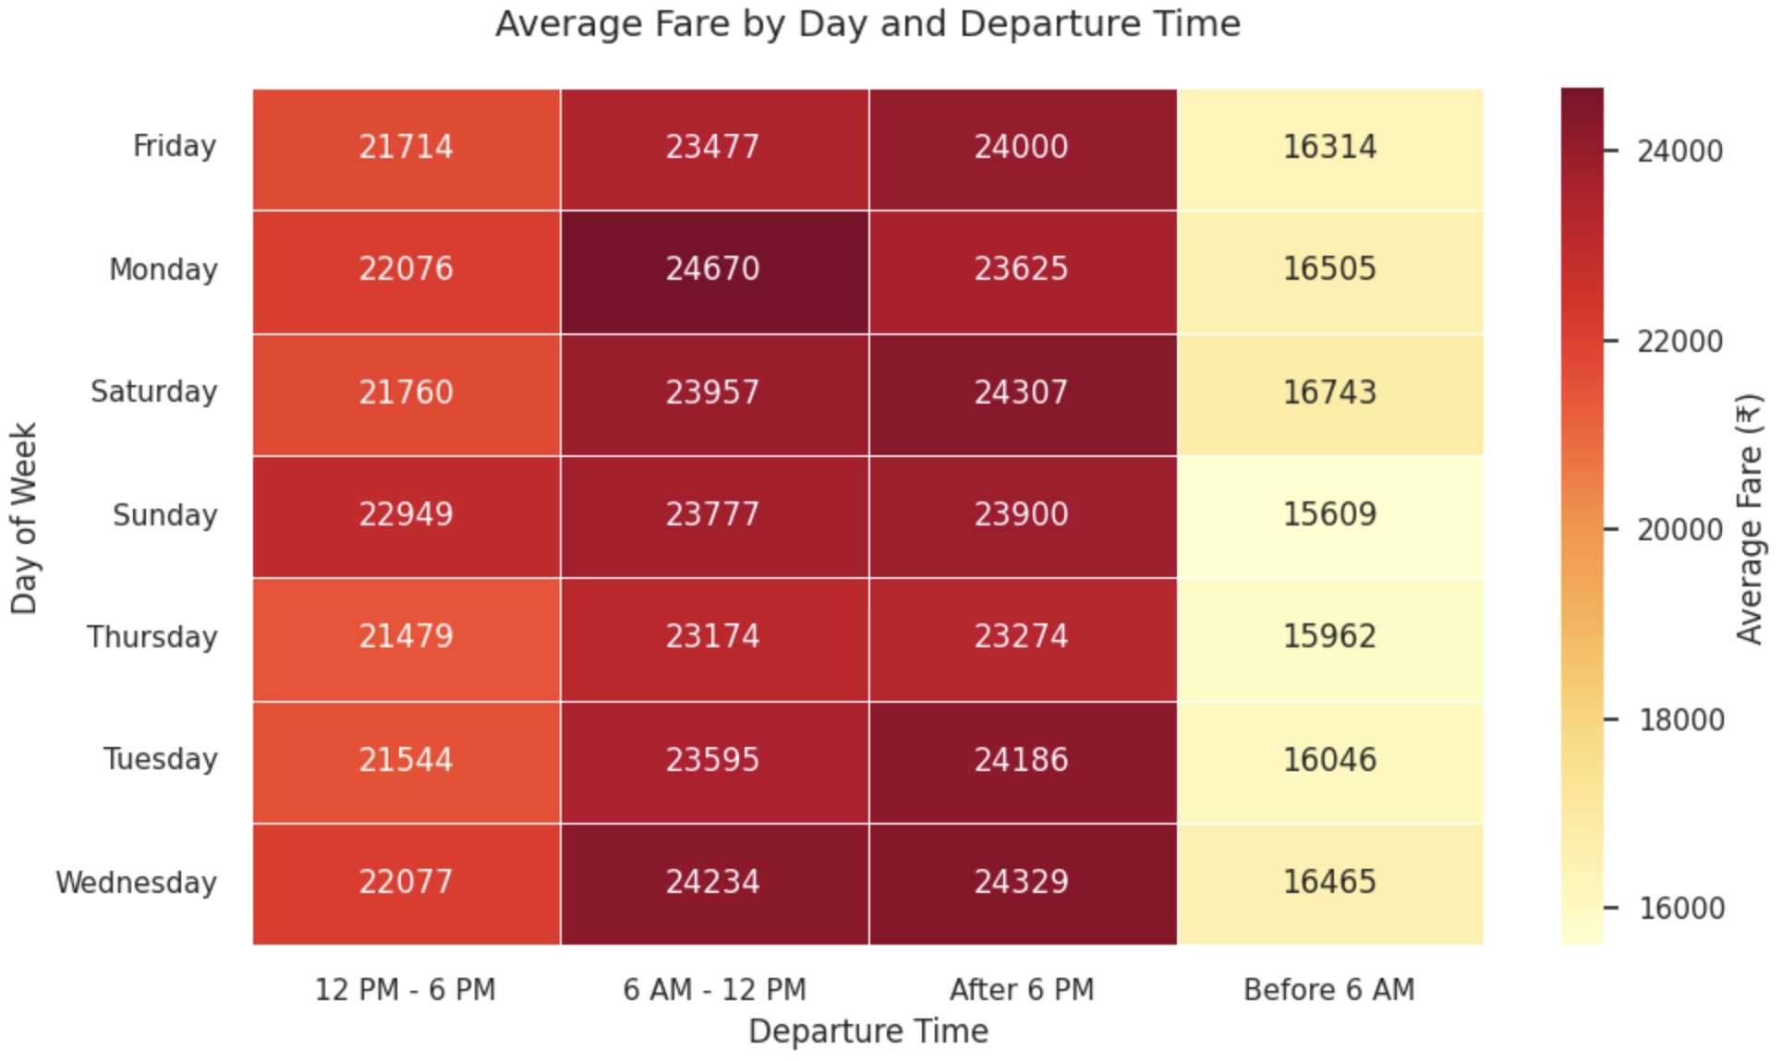
Feature Importance

Slide 11
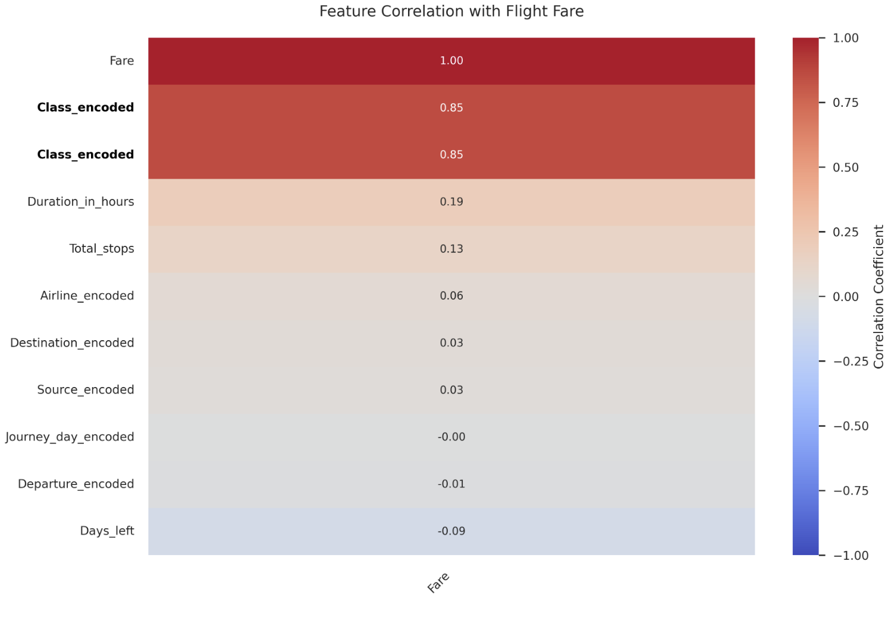
Feature Importance

Slide 12
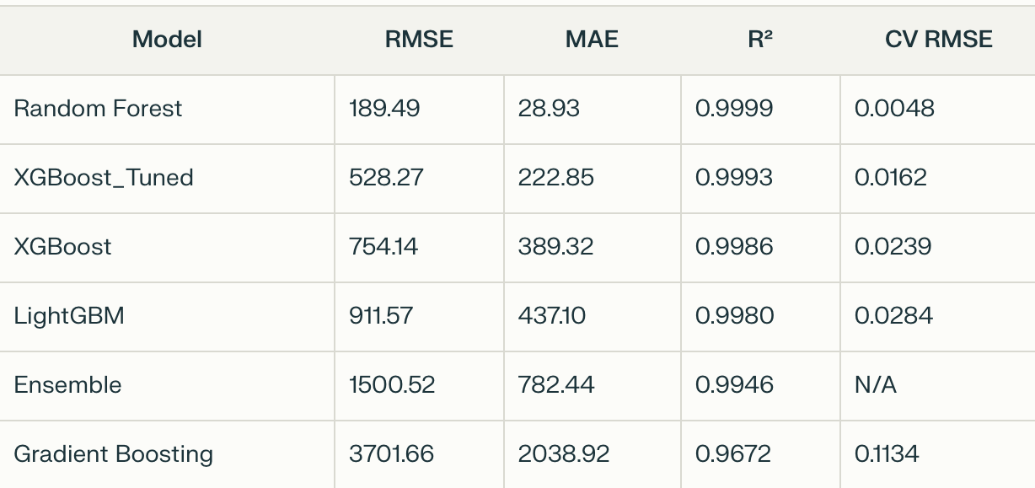
Performance

Slide 13
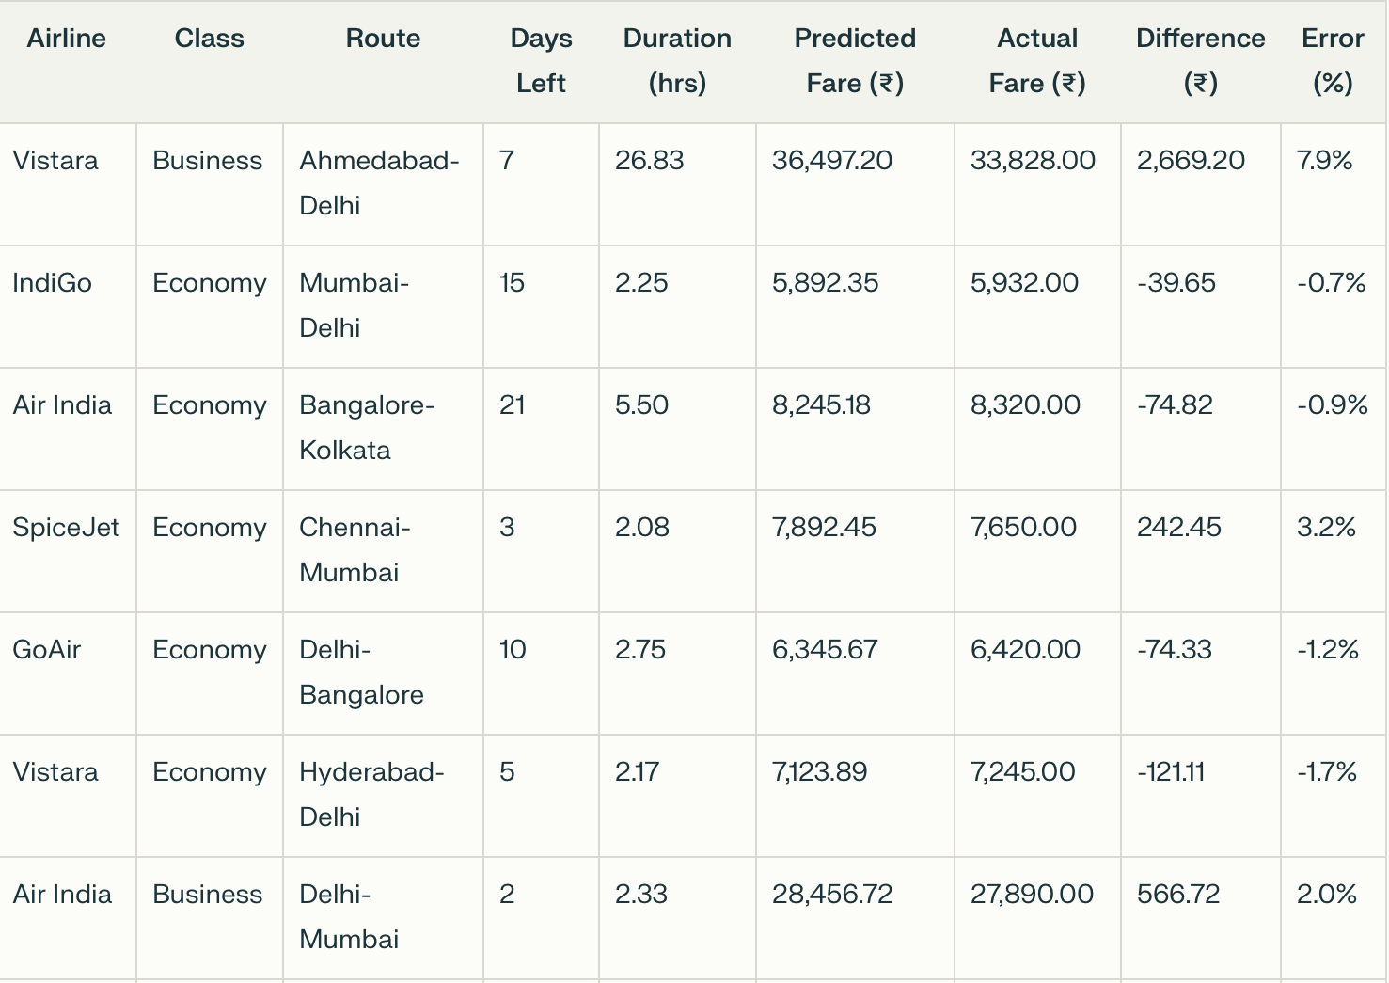
Prediction Results

Slide 14
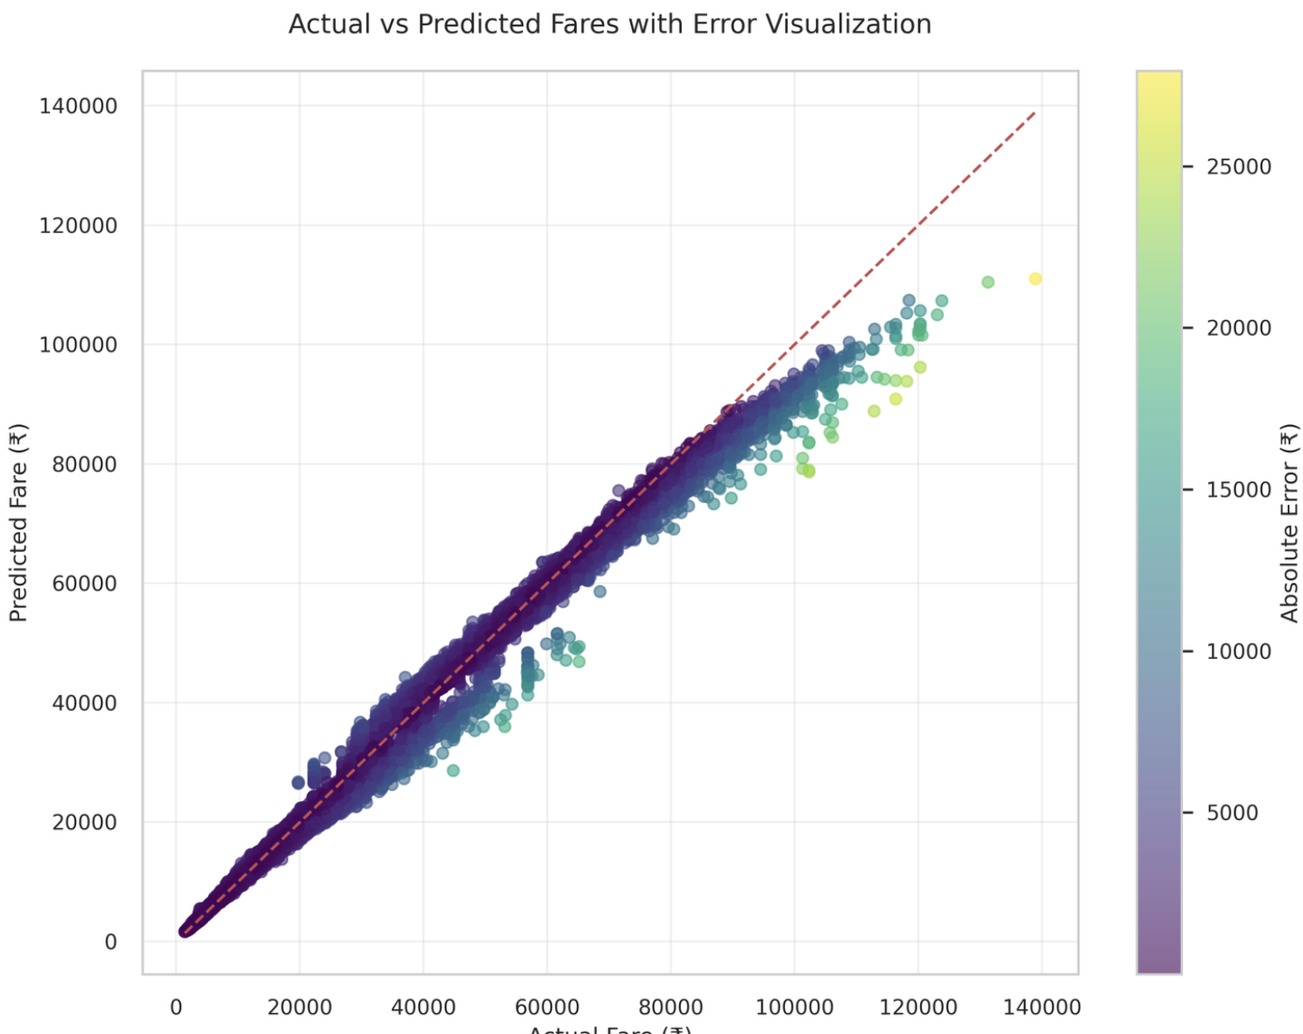
Prediction Results

Slide 15
Insights and Findings
Business Insights:
Fares increase significantly as departure date approaches
Weekend flights tend to be more expensive than weekdays
Business class tickets show less price volatility than Economy
Longer flights with more stops generally cost more per trip but less per hour
Certain airlines consistently charge premium prices regardless of route
Model Performance:
Random Forest model achieved exceptional accuracy (R² > 0.999)
Feature engineering significantly improved prediction quality
Log transformation effectively handled price skewness

Slide 16
Conclusion
Successfully built a highly accurate flight fare prediction model
Identified key factors influencing airline ticket pricing
Random Forest outperformed more complex models for this dataset

Slide 17
Thank You

